Slide 1
General Instructions
1. The template must remain unchanged.
2. Dimensions/ Slide size - A3 format only.
3. The patient's eyes should be masked, as shown in the sample slide.[ Black bar with 40% transparency, covering the entire image.]
4. Font style Calibri heading: 16 bold for the heading, 14 bold for subheadings, and Calibri body, 13 non-bold characters for the body of contents.
5. Images must occupy the entire box and should only be radiographs, lesions or procedural images (before and after). Photos of consent forms, lab reports, case logs, or any printed materials are not permitted.
6. Only high-resolution images should be used.
7. Slides should be arranged by department wise, with each department's name on a separate slide. The department name should have no borders, and the font should be Calibri, heading (bold), size 96.
8. Do not include case logs with nil significant findings.
9. For clinical revenue calculations, include the cost of investigations raised and the cost of minor procedures performed, such as catheterizations, IV fluids, injections, suturing, wound cleaning, and dressing, etc.
10. Attach proof of CME participation, conferences attended, publications, citations, and presentations at the end.
11. The cover page photo should be a casual photo without an apron or scrubs.

Slide 2
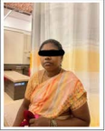
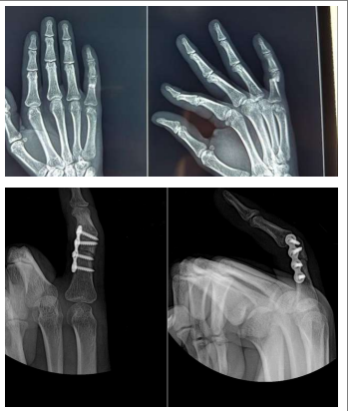
Student Name: Full name
Reg no: 111901074
A case of Delayed Union Of Right 5th Proximal Phalanx Displaced Fracture
S.no: 01 PID: 2315xxxxxxxxxx Age: 25 Gender: Female
Image
Radiological/ Specimen
Brief Clinical History:
c/o pain and swelling over the right hand x3months
History of presenting illness:
patient had an alleged h/o RTA-Hit by bike handle over the right hand and sustained injury to the right 5th proximal phalanx finger. No h/o trauma, ENT Bleed, LOC, seizure and vomiting
Patient Image
Patient’s workup:
Patient came with above mentioned complaints. Patient evaluated clinically and radio logically all routine investigation were done. Patient was diagnosed as 3month old delayed union of right 5th proximal phalanx displaced fracture. Patient was taken up for open reduction internal fixation with plate osteosynthesis for right proximal phalanx. Intraoperative and postoperative period was uneventful. During the course in hospital patient was treated with antibiotics and analgesics. Patient improved symptomatically and better hence been discharged with following medical advice.
SAMPLE
Clinical insights/ Differential Diagnosis:
Skin – normal ,minimal swelling present, no scar/sinus
Tenderness present over to the right 5th proximal phalanx
No warmth ,sensation intact, no DVND, rom- restricted and painful
Management:
Procedure done : open reduction internal fixation with plate osteosynthesis for the right 5th proximal phalanx
Approved by:- Name: Dr.xxxxyyyyy Designation: Assistant Professor Signature:

Slide 3
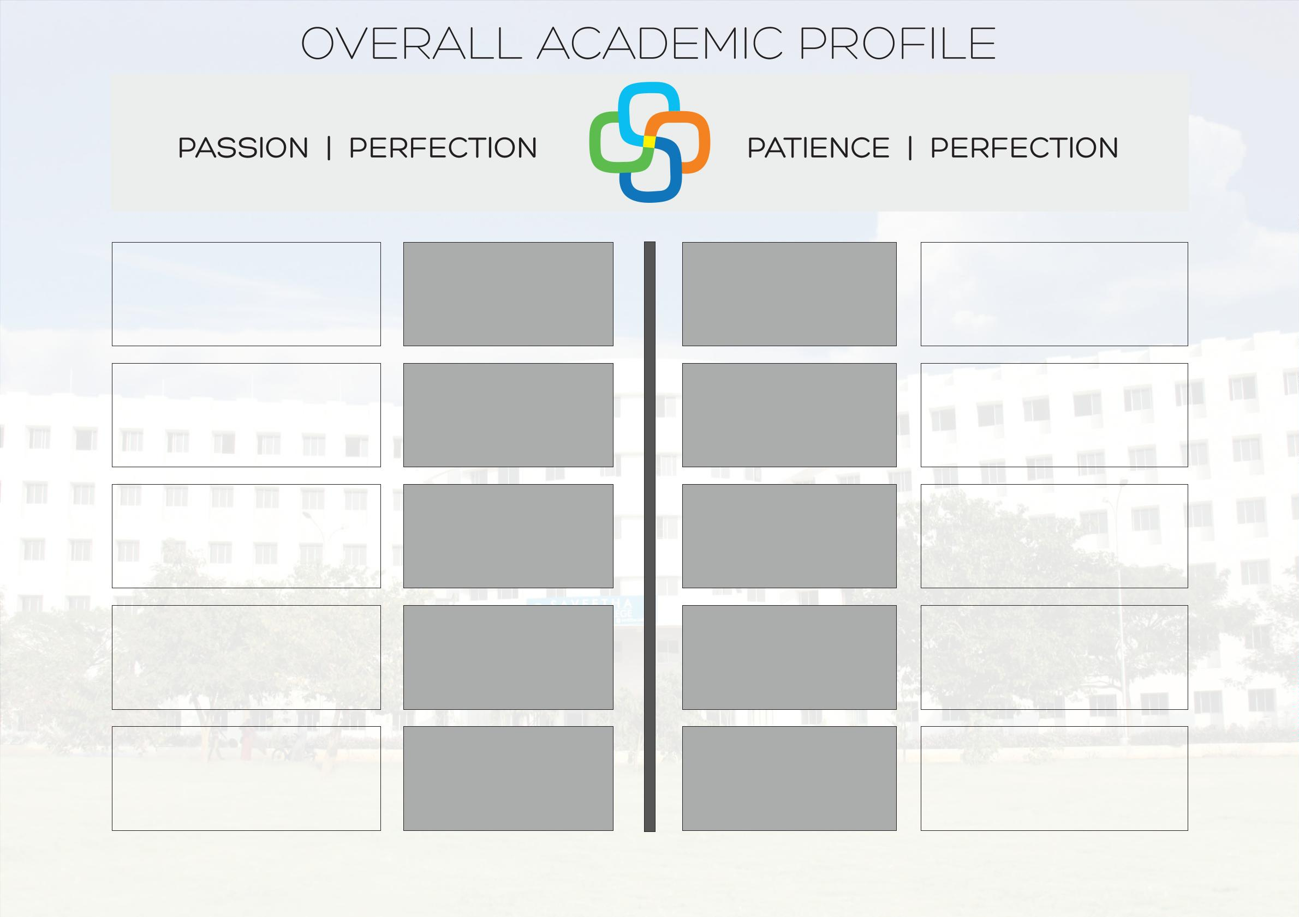
359 0
PROCEDURES
PAPER
PRESENTATIONS
9
CLINICAL CASES
PRESENTATIONS
36,30,300
POSTER
PRESENTATIONS
30
PRESENTATIONS
VALUE OF THERAPY
INR
82%
NATIONAL
CONFERENCE
30
ACADEMICS
ACADEMIC AWARDS
RESEARCH
DISTINCTION
PRESENTATIONS
27
AWARDS
INTERNATIONAL
CONFERENCE
14
PARTICIPATED
20
PUBLICATIONS
CITATIONS
1

Slide 4
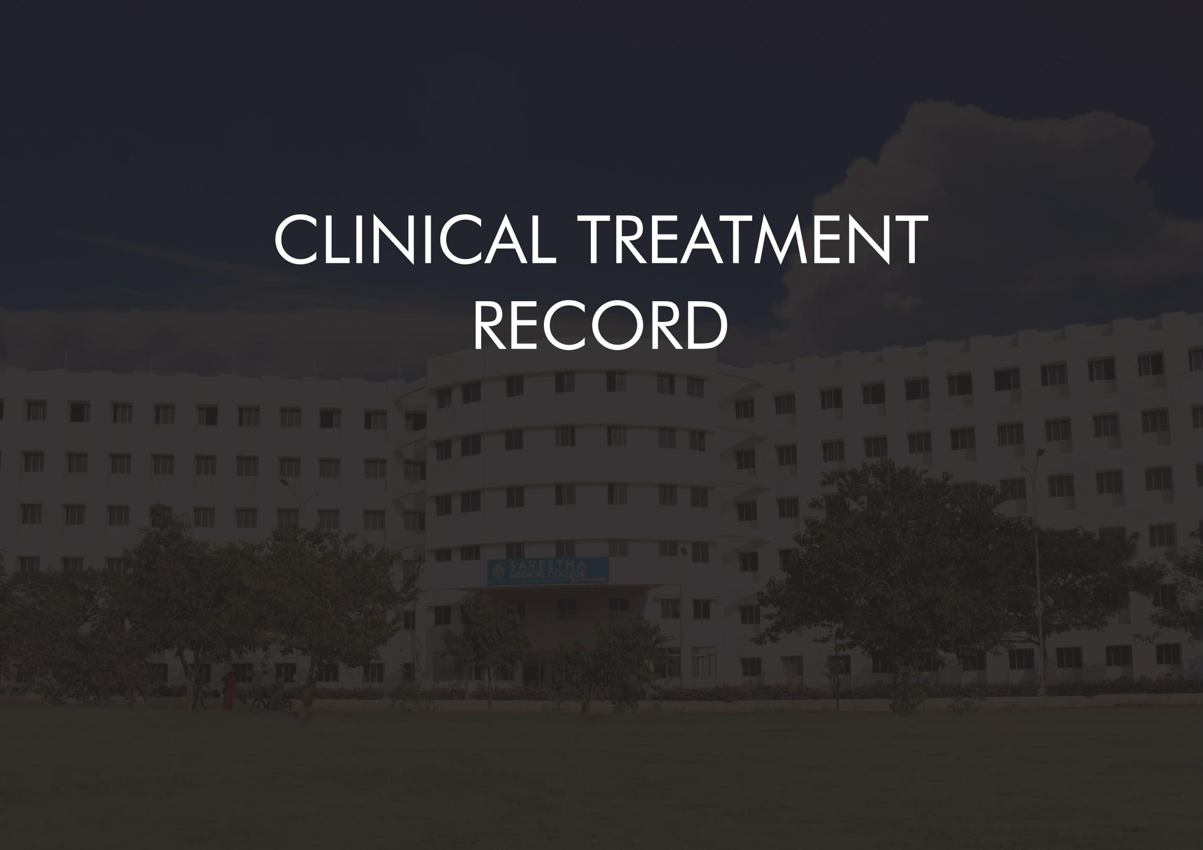
Clinical Documentation: 3590
Digital Documentation:
3590
Cumulative Clinical Revenue :
36,30,500

Slide 5
Reg no:
A case of
S.no: PID: Age: Gender: Diagnosis:
Student Name:
Image
Radiological/ Specimen
Brief Clinical History:
Patient Image
Patient’s workup:
USG/ ECHO/Microscopic
Image
Clinical insights/ Differential Diagnosis:
Management:
Approved by:- Name: Designation: Signature:

Slide 6
Reg no:
A case of
S.no: PID: Age: Gender: Diagnosis:
Student Name:
Image
Radiological/ Specimen
Brief Clinical History:
Patient Image
Patient’s workup:
Clinical insights/ Differential Diagnosis:
Management :
Approved by:- Name: Designation: Signature:

Slide 7


